Slide 1
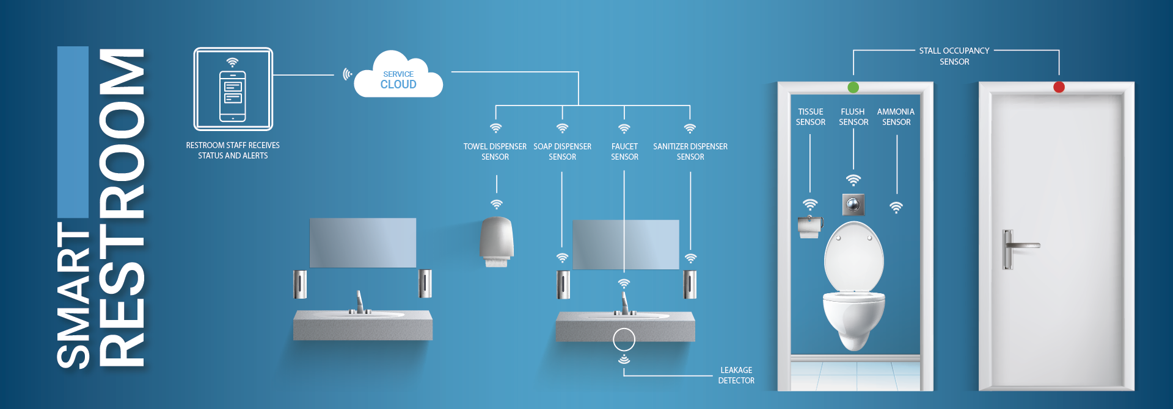
Smart public rest room

Slide 2

DEFINITION
Smart public restrooms are public restrooms that use the Internet of Things (IOT) to improve hygiene, maintenance, and user experience. They use a variety of sensors and devices to collect data about the restroom environment and usage, which is then used to automate tasks and provide real-time information to users and restroom managers.

Slide 3
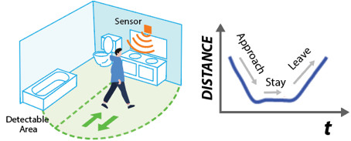
MODULES:
Occupancy sensors:
These sensors detect whether or not a restroom stall is occupied, which can be used to display occupancy status to users and to trigger automated tasks, such as flushing toilets and turning on lights.

Slide 4
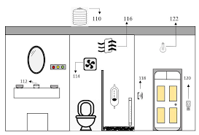
Hygiene sensors:
These sensors detect the cleanliness of the restroom environment, such as the presence of dirt or bacteria on surfaces. This data can be used to trigger automated cleaning tasks or to alert restroom managers of potential hygiene issues.

Slide 5
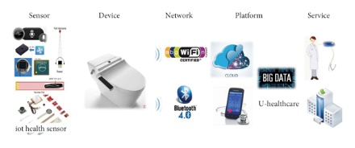
Usage sensors:
These sensors track how often different restroom facilities are used. This data can be used to optimize maintenance schedules and to identify areas where additional facilities may be needed.

Slide 6
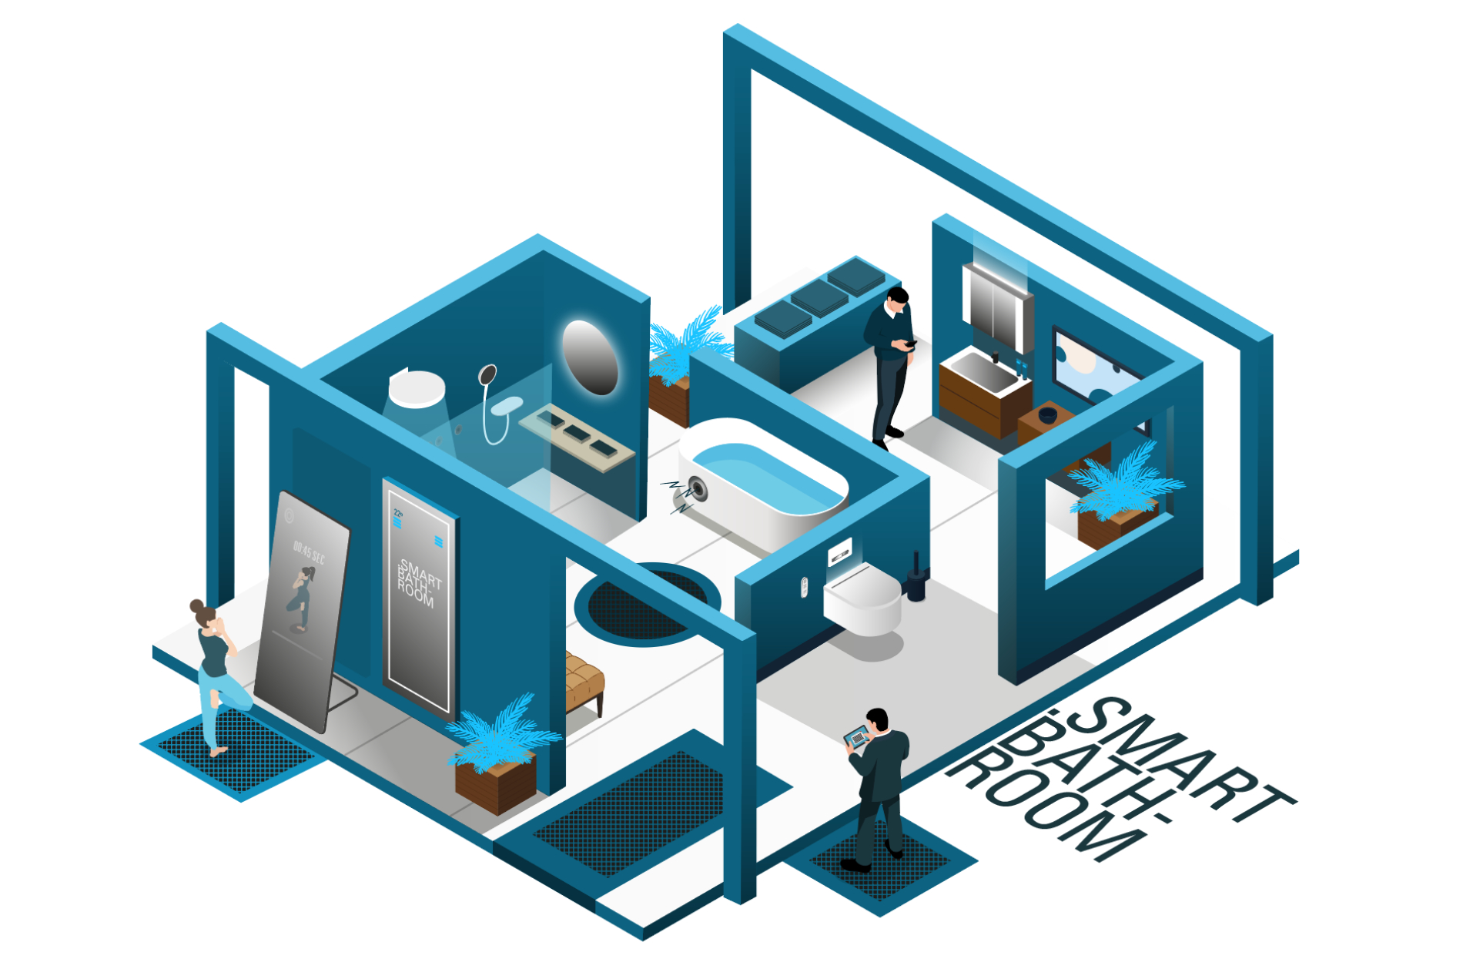
Smart futures:
Smart futures, such as toilets, faucets, and soap dispensers, can be used to automatic tasks and to reduce water and energy consumption. For example, a smart toilet may flush automatically when the user stands up.

Slide 7
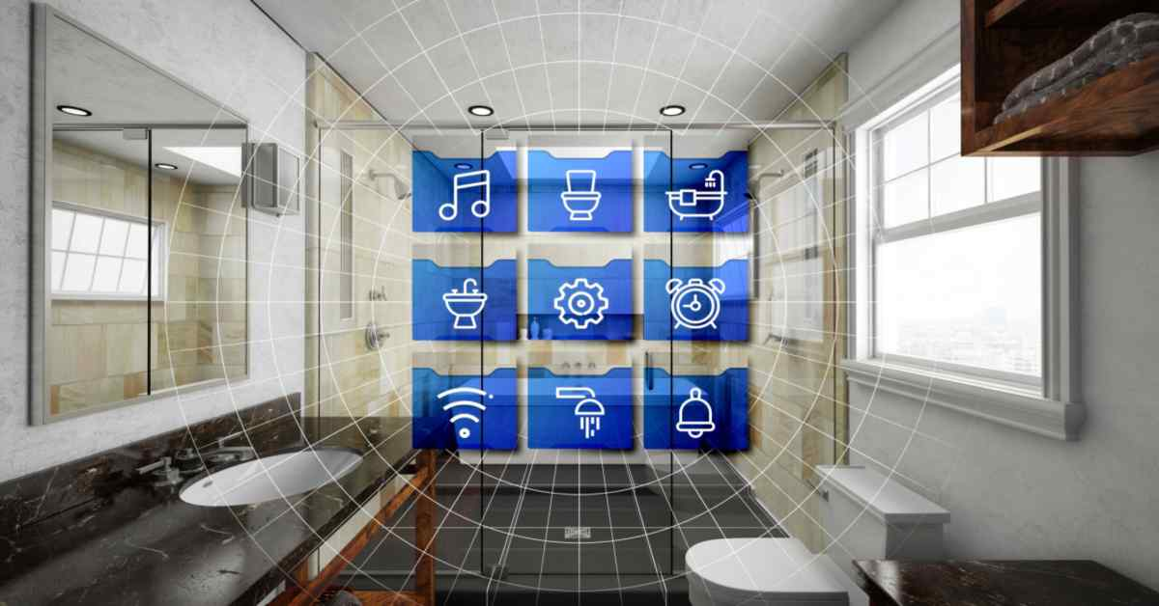
Real-time information displays: These displays provide users with real-time information about the restroom environment, such as occupancy status, hygiene levels, and the availability of supplies.

Slide 8

Benefits
Improved hygiene:
Smart restrooms can help to improve hygiene by automating cleaning tasks and by alerting restroom managers of potential hygiene issues.

Slide 9
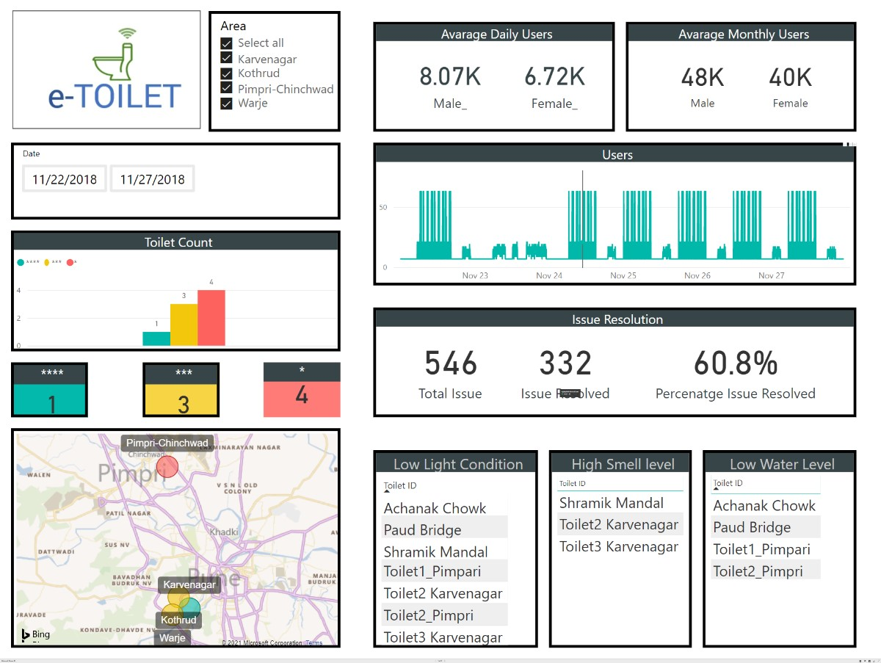
Reduced maintenance costs:
Smart restrooms can help to reduce maintenance costs by optimizing maintenance schedules and by identifying areas where additional maintenance may be needed

Slide 10
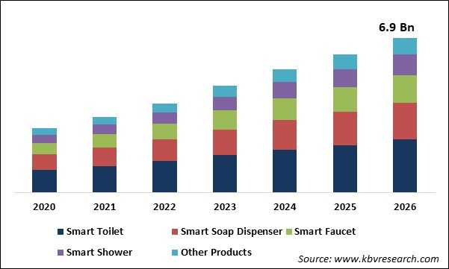
Improved user experience:
Smart restrooms can improve the user experience by providing real-time information about the restroom environment and by automating tasks, such as flushing toilets and turning on lights.

Slide 11

Conclusion:
Smart public restrooms are a promising new technology that can help to improve hygiene, maintenance, and user experience in public restrooms. As the cost of IOT devices and technologies continues to decline, it is likely that smart public restrooms will become more common in the coming years.

